Slide 1
Design of Adaptive Motor Controller with Built in Microcontroller and I²C Control
Senior Design Project
Justin Derickson

Slide 2
Objective
The objective of this project is to develop a standalone system that will address power distribution, motor and servo control, and general input and output in a single unit.
Notes:
Asked by a colleague to help troubleshoot some wiring issues with a research project.
Diagrams were not kept up to date.
Electronics enclosure was crowded and disorganized.
Total disassembly was required to fix issue.

Slide 3
Design Requirements
Three sets of requirements:
Output Requirements
Power and Control Requirements
System should be small and inexpensive.
Hardware and Firmware requirements

Slide 4
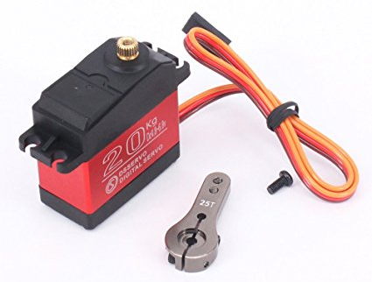
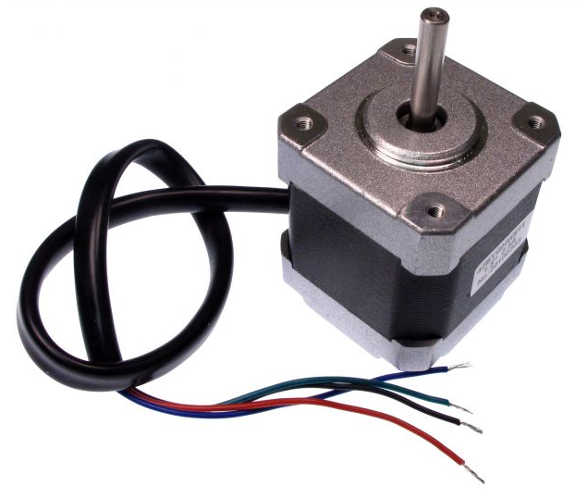
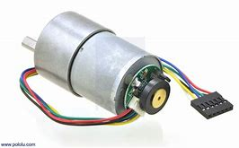
Design Requirements: Input andOutput
Control a single bipolar stepper motor or up to two DC motors
5 - 24V operating voltage
1.5 A maximum current per winding or motor
general purpose I/O for quadrature encoder feedback
PWM output for stepper motor control

Slide 5
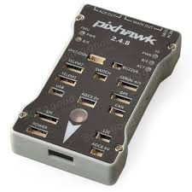
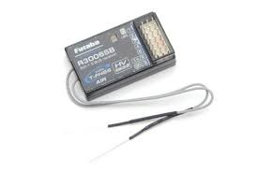
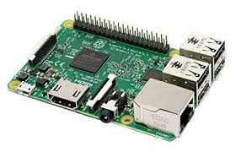
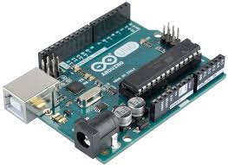
Design Requirements: Power and Control
power supply voltage from 9 - 24 V
provide a stable 5V source to power external devices
I2C and PWM compatible
General I/O
Notes:
I2C would like come from a raspberry pi or arduino.
PWM would likely come from an RC receiver.
PWM more likely to control lower level functions like throttle and steering.
I2C and onboard switches will dictate higher functions

Slide 6
Design Constraint
Budget

Slide 7
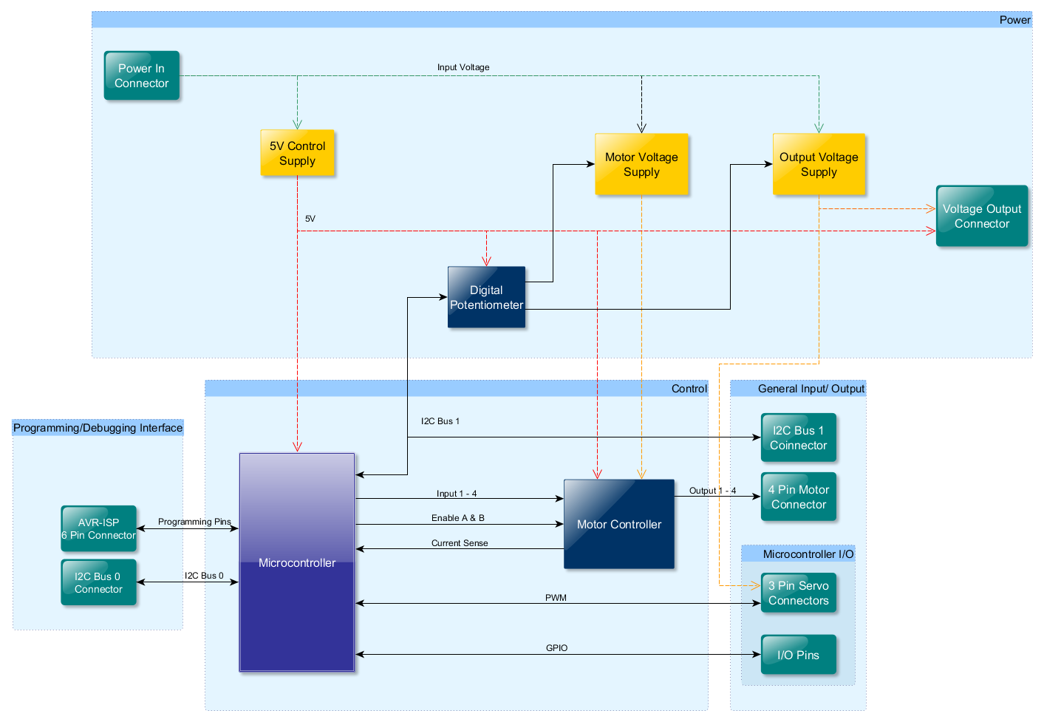
System Diagram
System Diagram:

Slide 8
System Functions
Motor Driver:
Accept logical input for bipolar stepper motor control.
Allow for DC motor control using came connections as stepper motor.
Microprocessor
Supplies control logic to motor driver.
Communicates with external devices.

Slide 9
Task List
Task 1. Control System Design
Task 2. Power System Design
Task 3. Verification
Task 4. PCB Design
Task 6 Final Assembly and Testing

Slide 10
Implementation
of Tasks
Projected Timeline and Delivery Plan over 45 weeks
Circuit Design Week 1 - Week 10
Prototyping / Testing Week 11 - Week 13
PCB Layout Week 14 - Week 17
Firmware Coding Week 18 - Week 21
Assembly and Testing Week 22 - Week 24

Slide 11
Task 1 Control Section Design

Slide 12
Task 1: CircuitMaker by Altium
Free
Large, community-driven component database
Components linked to footprints and vendors
3D-Rendering capability

Slide 13
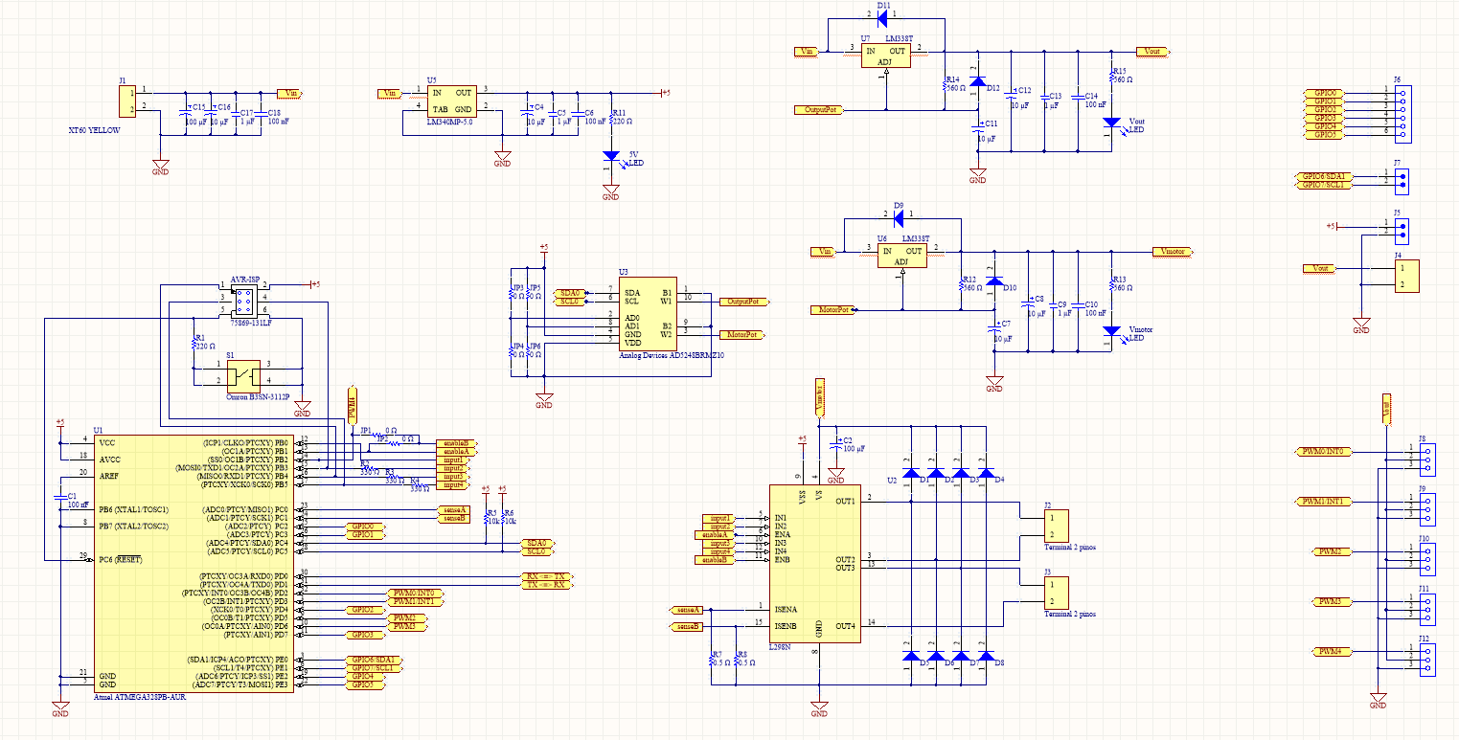
Finalized Schematic

Slide 14
Task 1: Control Section Design Motor Driver
Requirements
Implement Full, Half, and Microstepping in a Bipolar Stepper Motor.
Independent dual DC motor control.

Slide 15
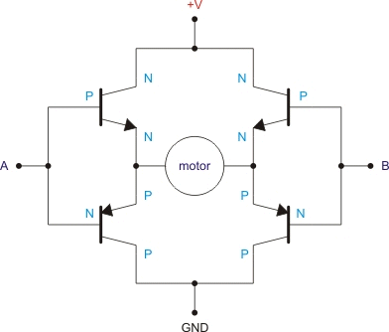
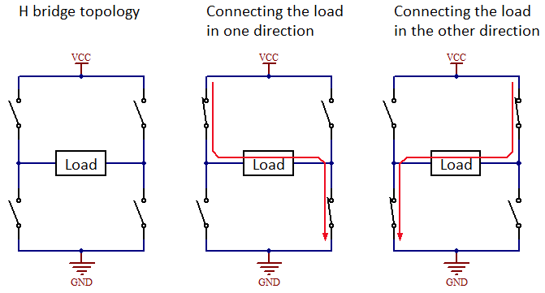
Task 1: Control Section Design Motor Driver
H-Bridge
Change direction of current through load.
Change current through load with Enable

Slide 16
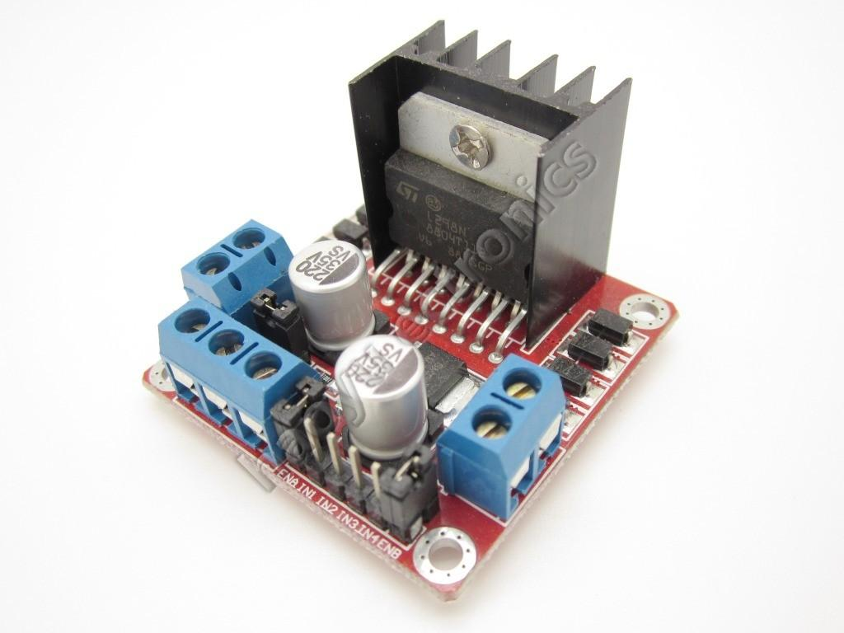
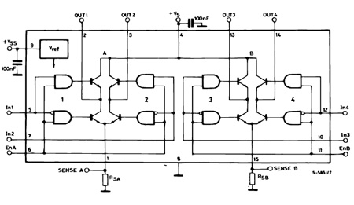
Task 1: Control Section Design Motor Driver: L298N
L298N Dual H-Bridge
Max Supply Voltage 48V
Logic Supply Voltage 5V
Total DC current 4A
Enable pin for each winding
Current Sensing

Slide 17
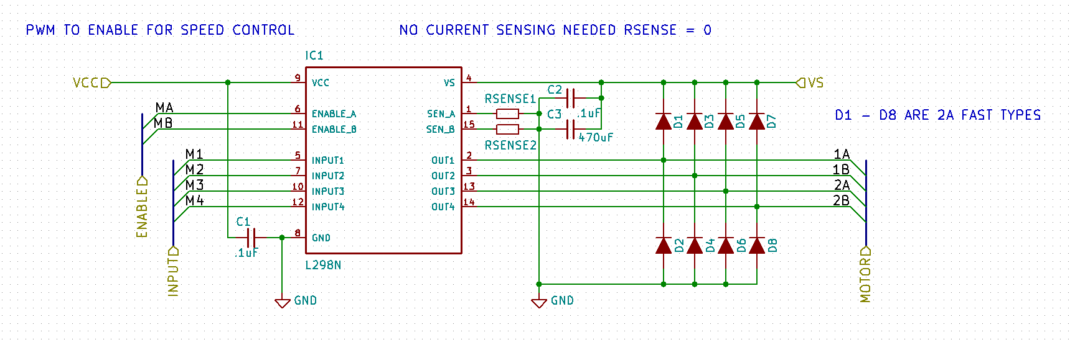
Task 1: Control Section Design Motor Driver:
Schematic
D1 – D8 are 2A fast switching diodes to protect against back emf from motors

Slide 18
Task 1: Control Section Design Microcontroller:
Requirements
I2C and PWM for device and sensor interfacing.
UART for USB Programming.

Slide 19
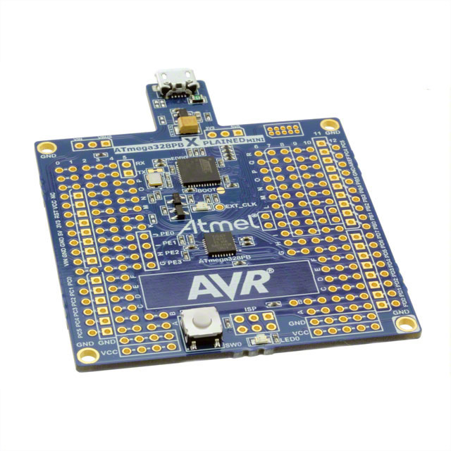
Task 1: Control Section Design Microcontroller: ATmega328PB
Operating Voltage: 1.8 to 5.5V
Memory: 32KB
Programmable Flash: 1KB EEPROM 2KB SRAM
CPU speed: 20 MIPS @ 20MHz
PWM Peripherals: 10 channels
Communication Peripherals: 2-UART, 2-SPI, 2-I2C

Slide 20
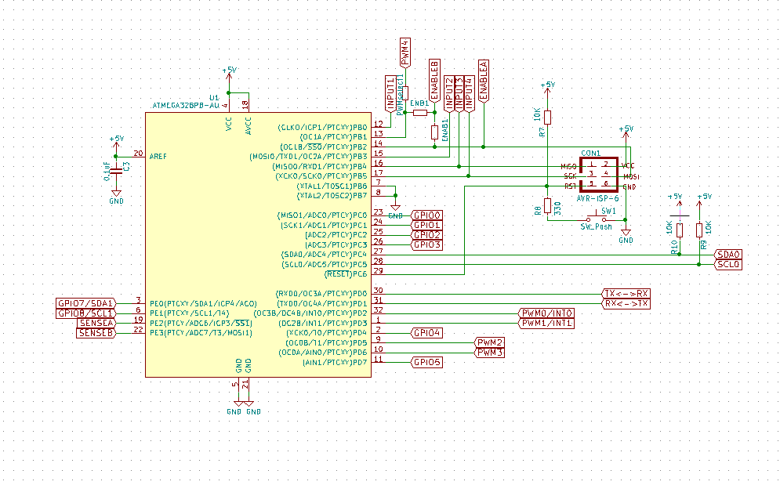
Task 1: Control Section Design Motor Driver:
Schematic

Slide 21
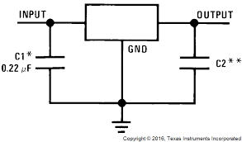
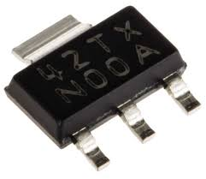
Task 2 Power Section Design 5V Supply
LM340MP Linear Regulator
Operating Voltage 7.5V - 35V
Output voltage 5V
Output Current 1A
Notes:
Current Calculations

Slide 22
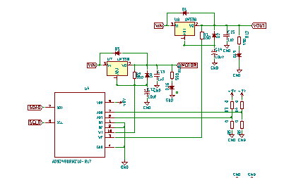
Task 2: Power Section Design
Two Separately controllable voltage regulators
Controlled by a single I2C dual channel digital potentiometer

Slide 23
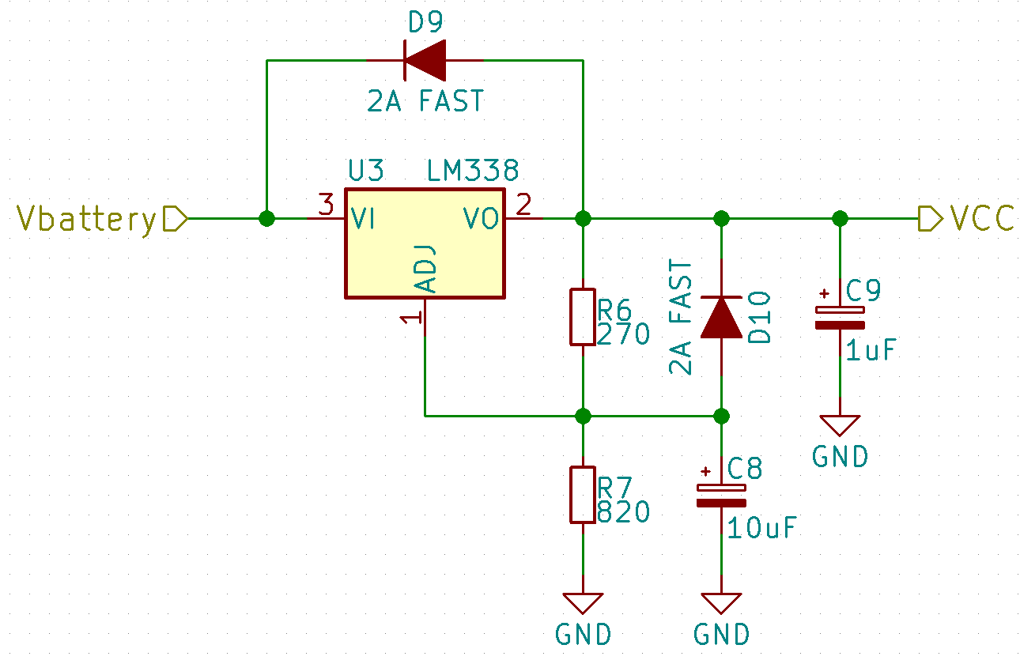
Task 2 Power Section Design Variable Supply
Schematic
C9 improves transient response.
C8 improves ripple rejection.
D9 & D10 provide discharge path around regulator.
Notes:
C9 improves transient response. C8 improves ripple rejection. D9 & D10 provide discharge path around regulator output.

Slide 24
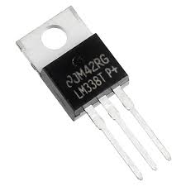
Task 2 Power Section Design Variable Supply
Schematic
LM338 Adjustable Linear Regulator
Operating Voltage: 4.2V - 40V
Output voltage 1.24V – 32V
Output Current 5A

Slide 25
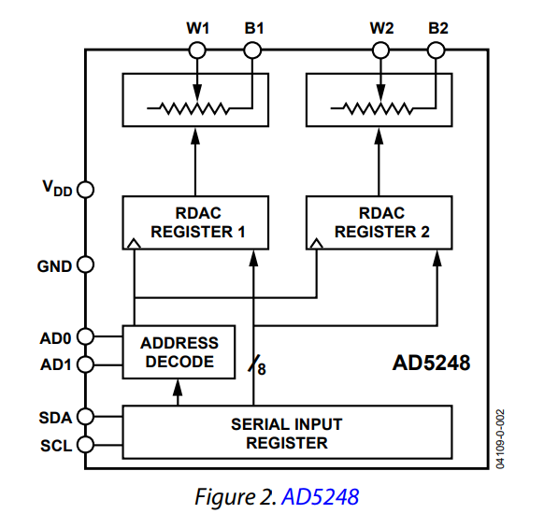
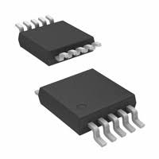
Task 2 Power Section Design: Digital Pot
AD5248BRMZ10
I2C compatible
2-Channel, 256 position potentiometer
10kΩ end to end resistance
Single supply 2.7v to 5.5v
Notes:
While this component is designed as a LED driver, It produces a PWM output easily configured for operating servos.

Slide 26
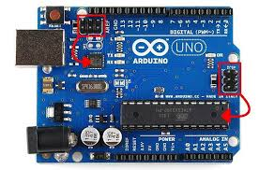
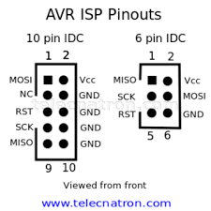
Task 3 Programming/ Debugging Design: AVR-ISP connector
AVR Devices are initially programmed through a 6 or 10 pin header connected to pins on the microcontroller
This device will use a 6 pin header
Needed to install bootloader that runs programs and allows for serial programming through usb e.g. Arduino
Single wire debugging is done through reset pin of isp header

Slide 27
Task 4 : System Verification

Slide 28
Task 4 Design Verification
the ATmega328PB Xplained development board
Inexpensive: $9.00 on Amazon
DebugWire: Debugging through ISP port using serial communication on RESET pin
Arduino Compatible: Arduino header connectors can be added to board for debugging using arduino.

Slide 29
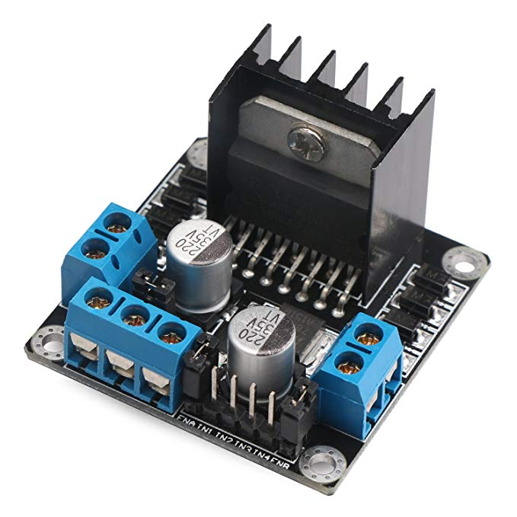
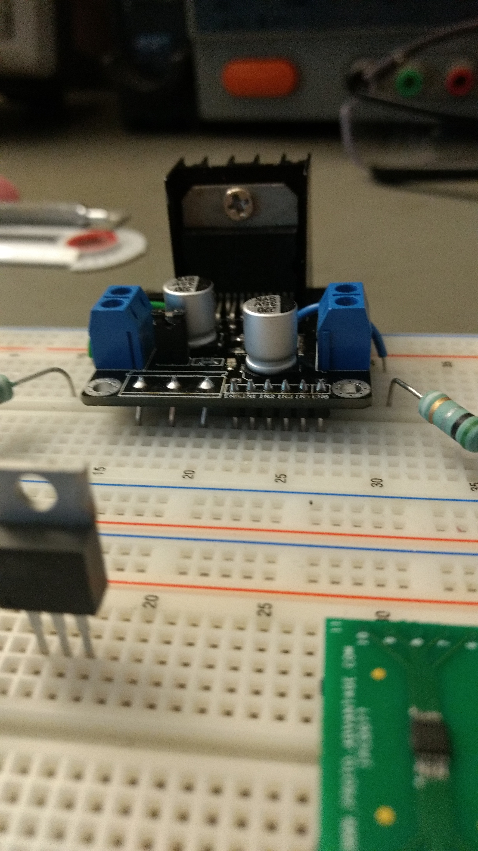
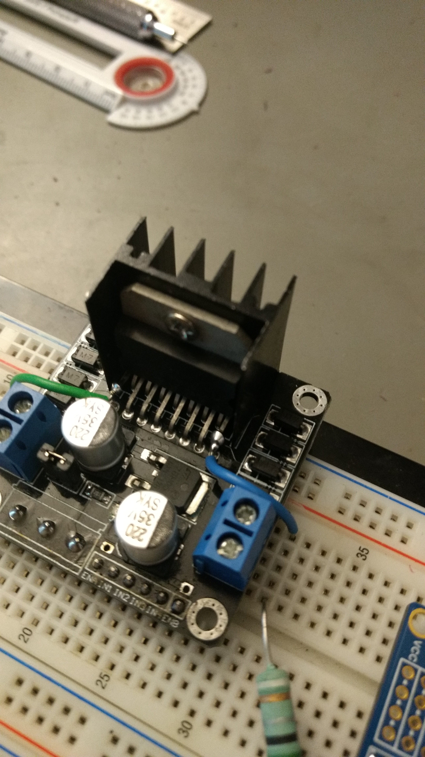
Task 4 Design Verification L298N Motor Driver Board Modifications
Replaced Power, Input, and Enable connectors with breadboard compatible header pins
Cut Sense Pins from board to connect 0.5 Ω current sense resistors.

Slide 30
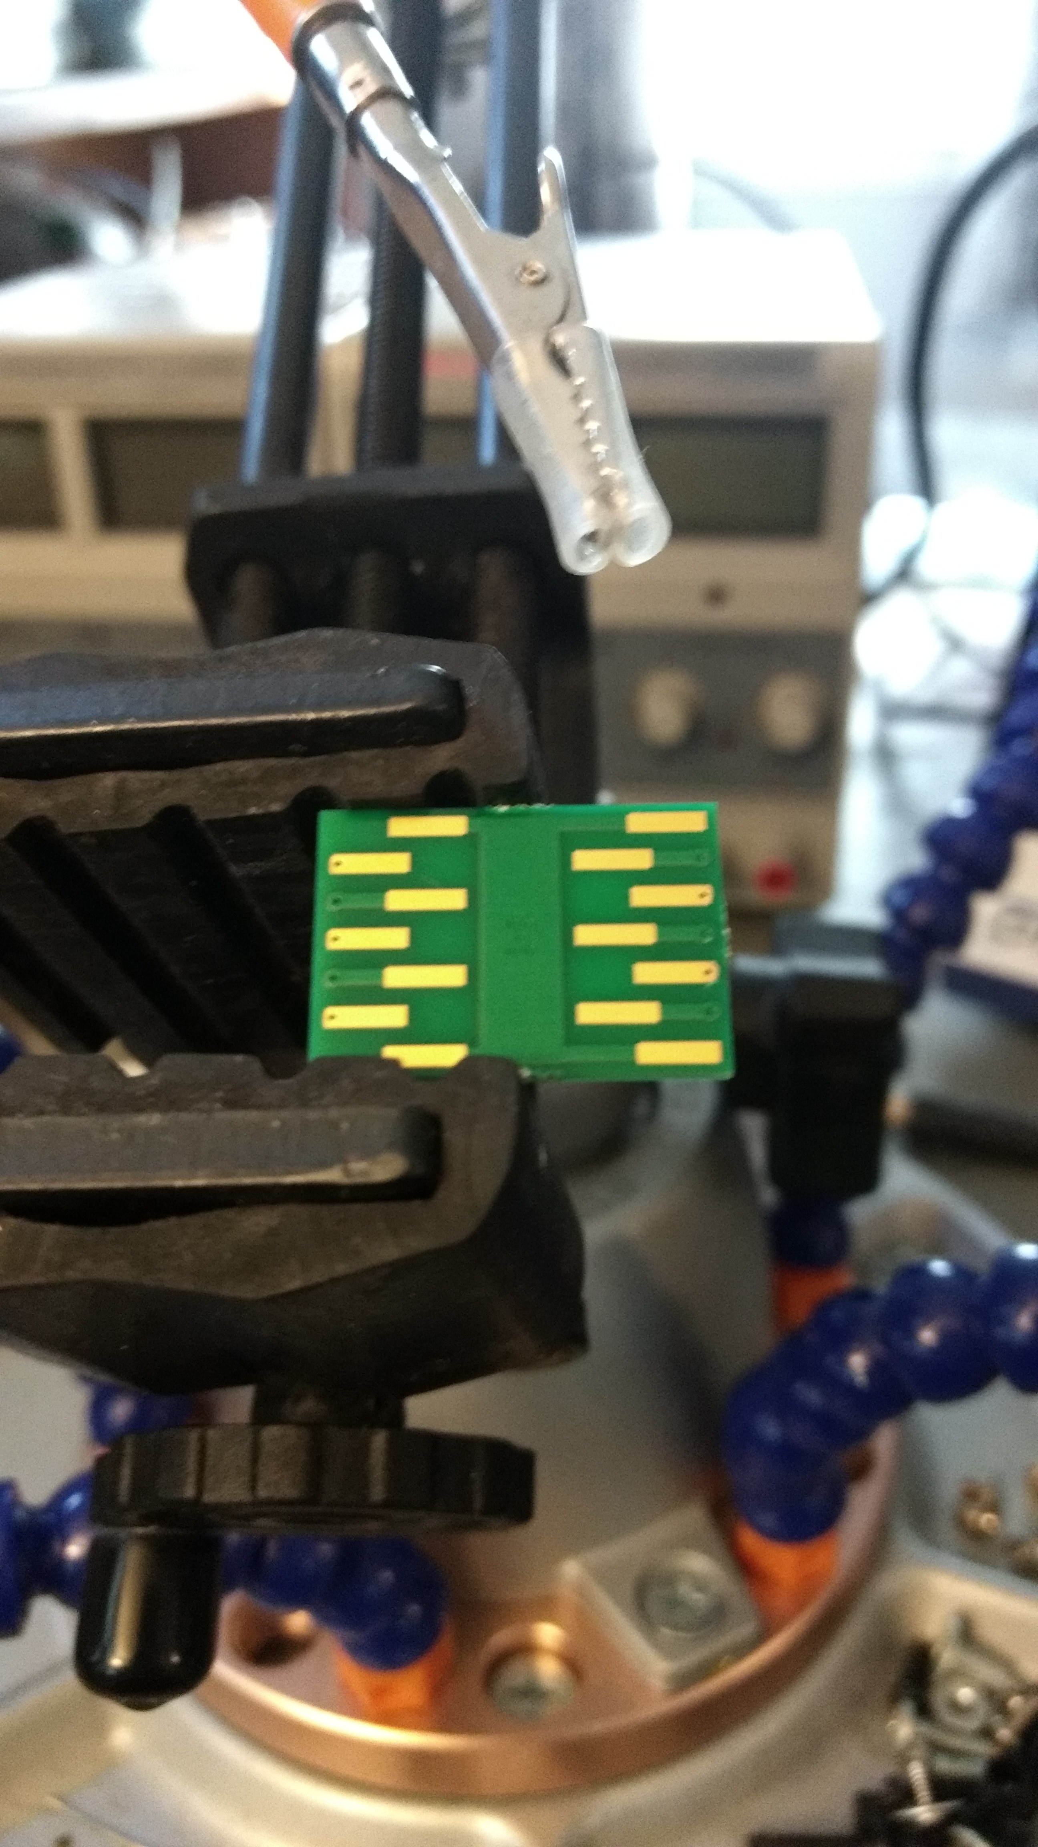
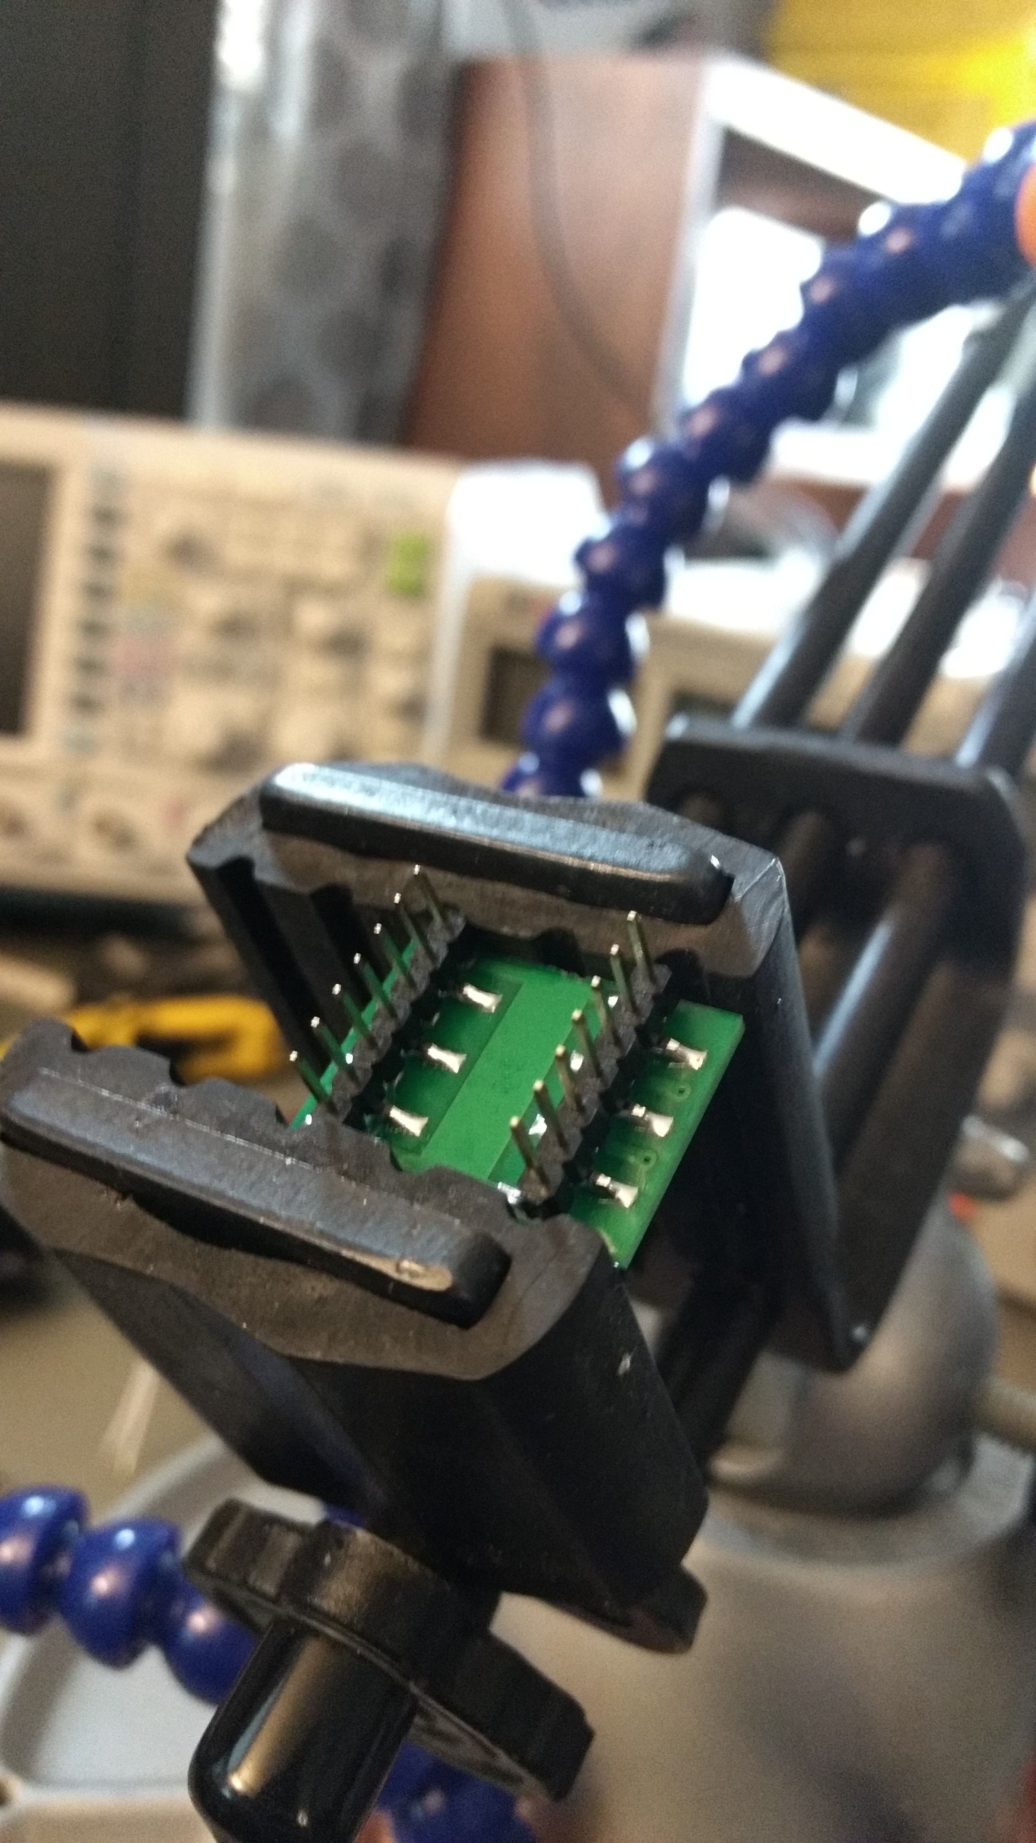
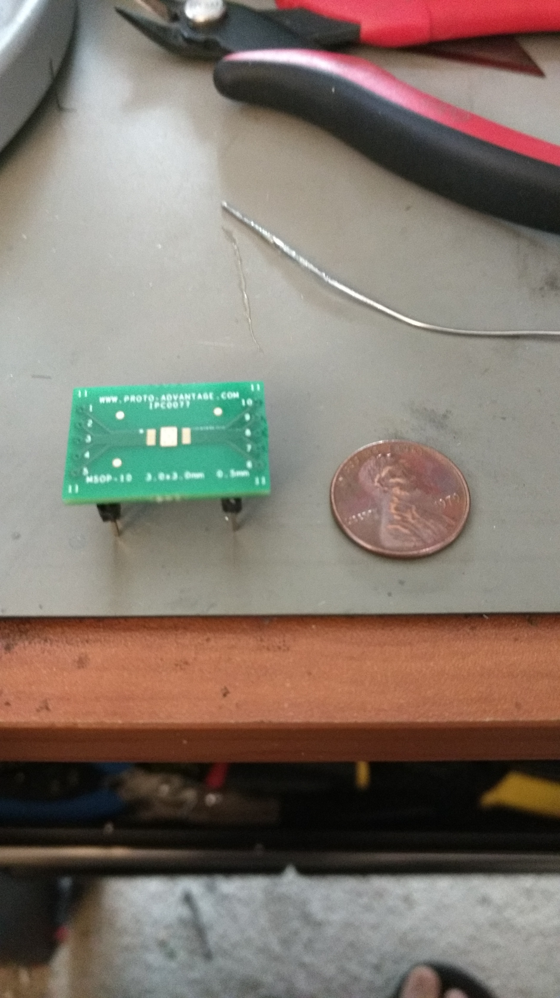
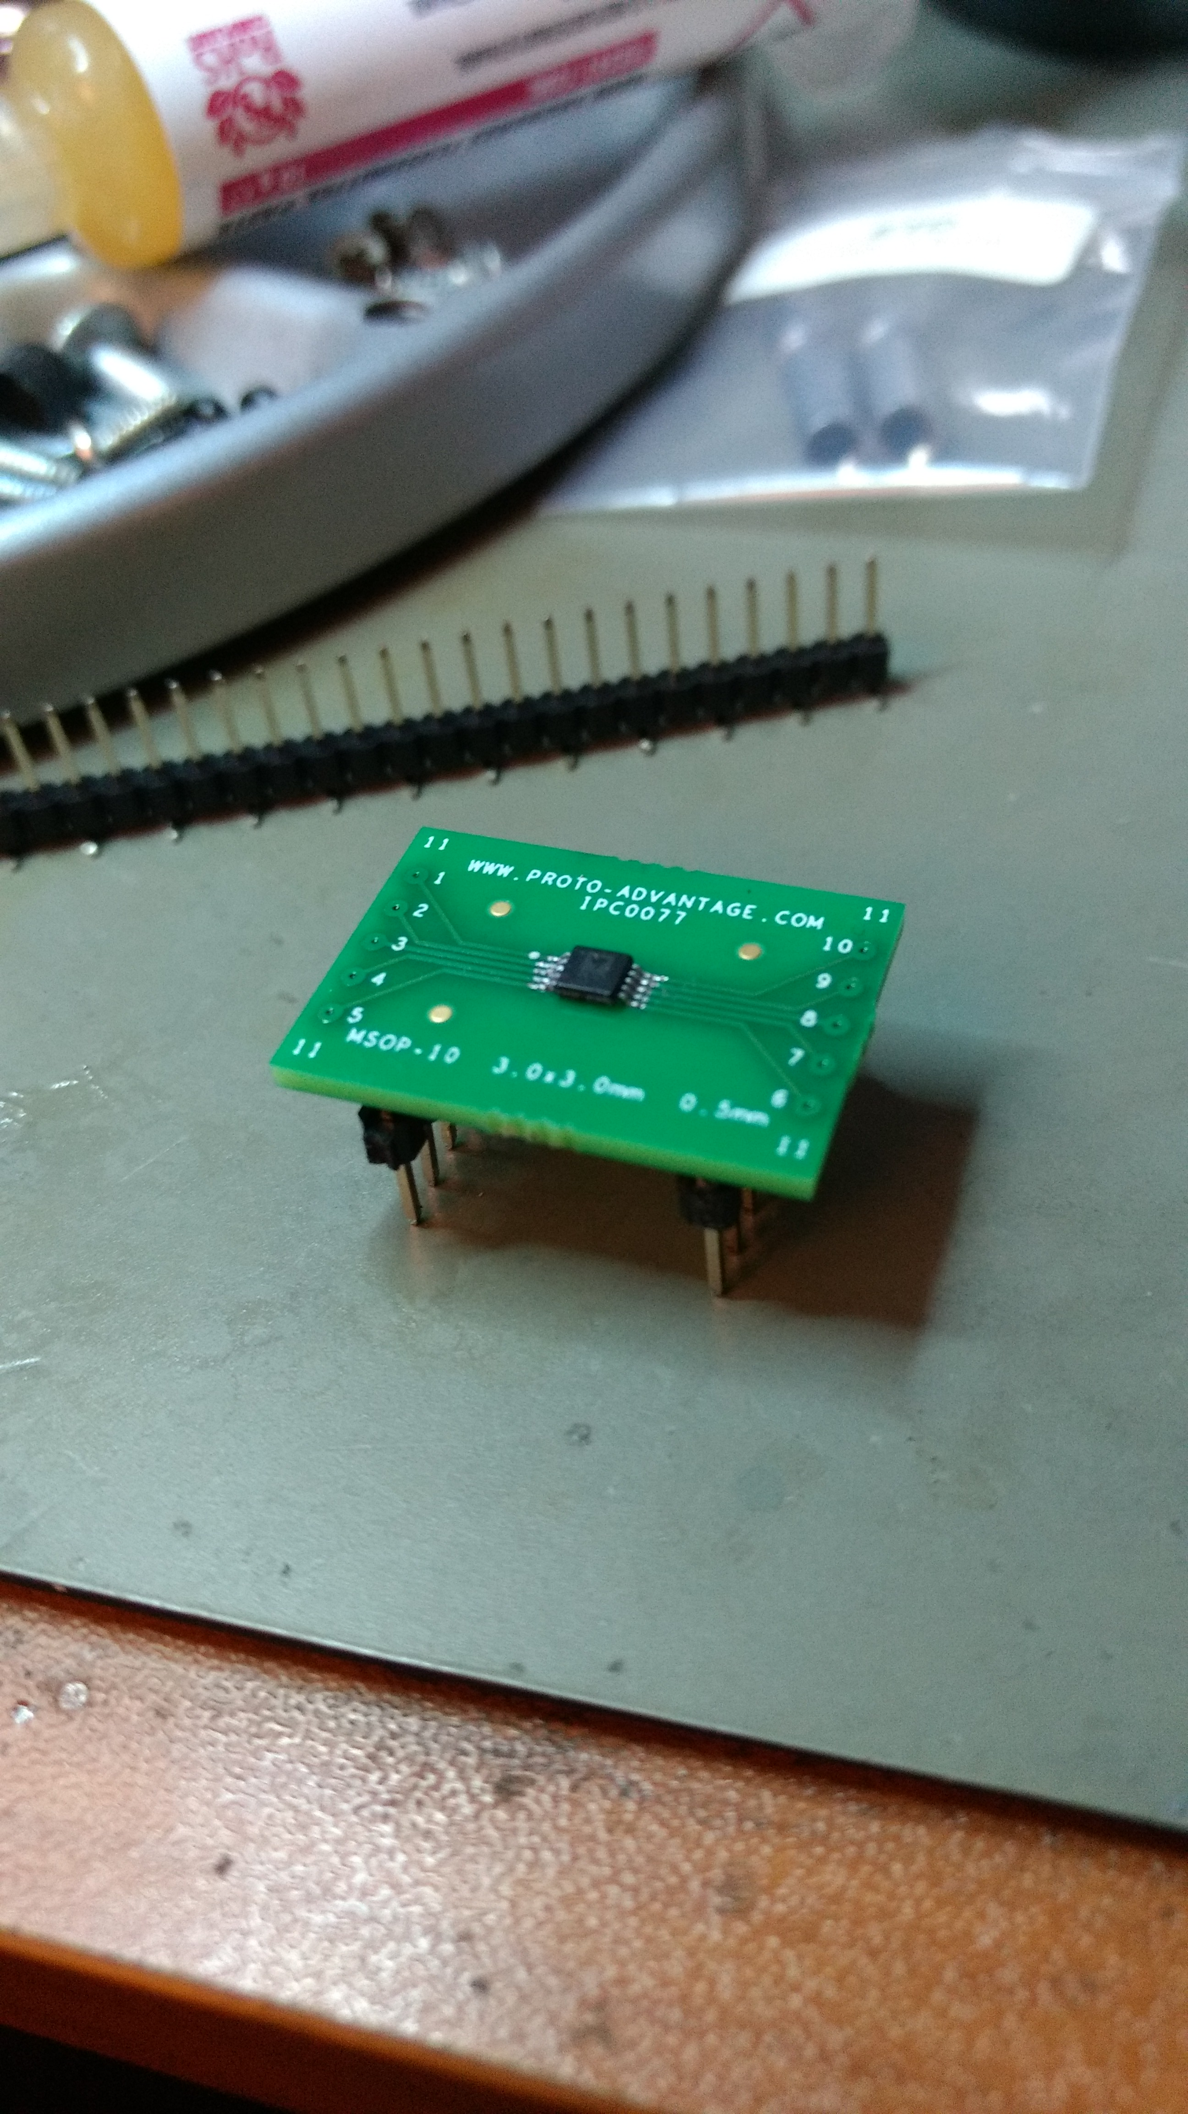
Task 4 Design Verification Digital Potentiometer Breakout Assembly

Slide 31
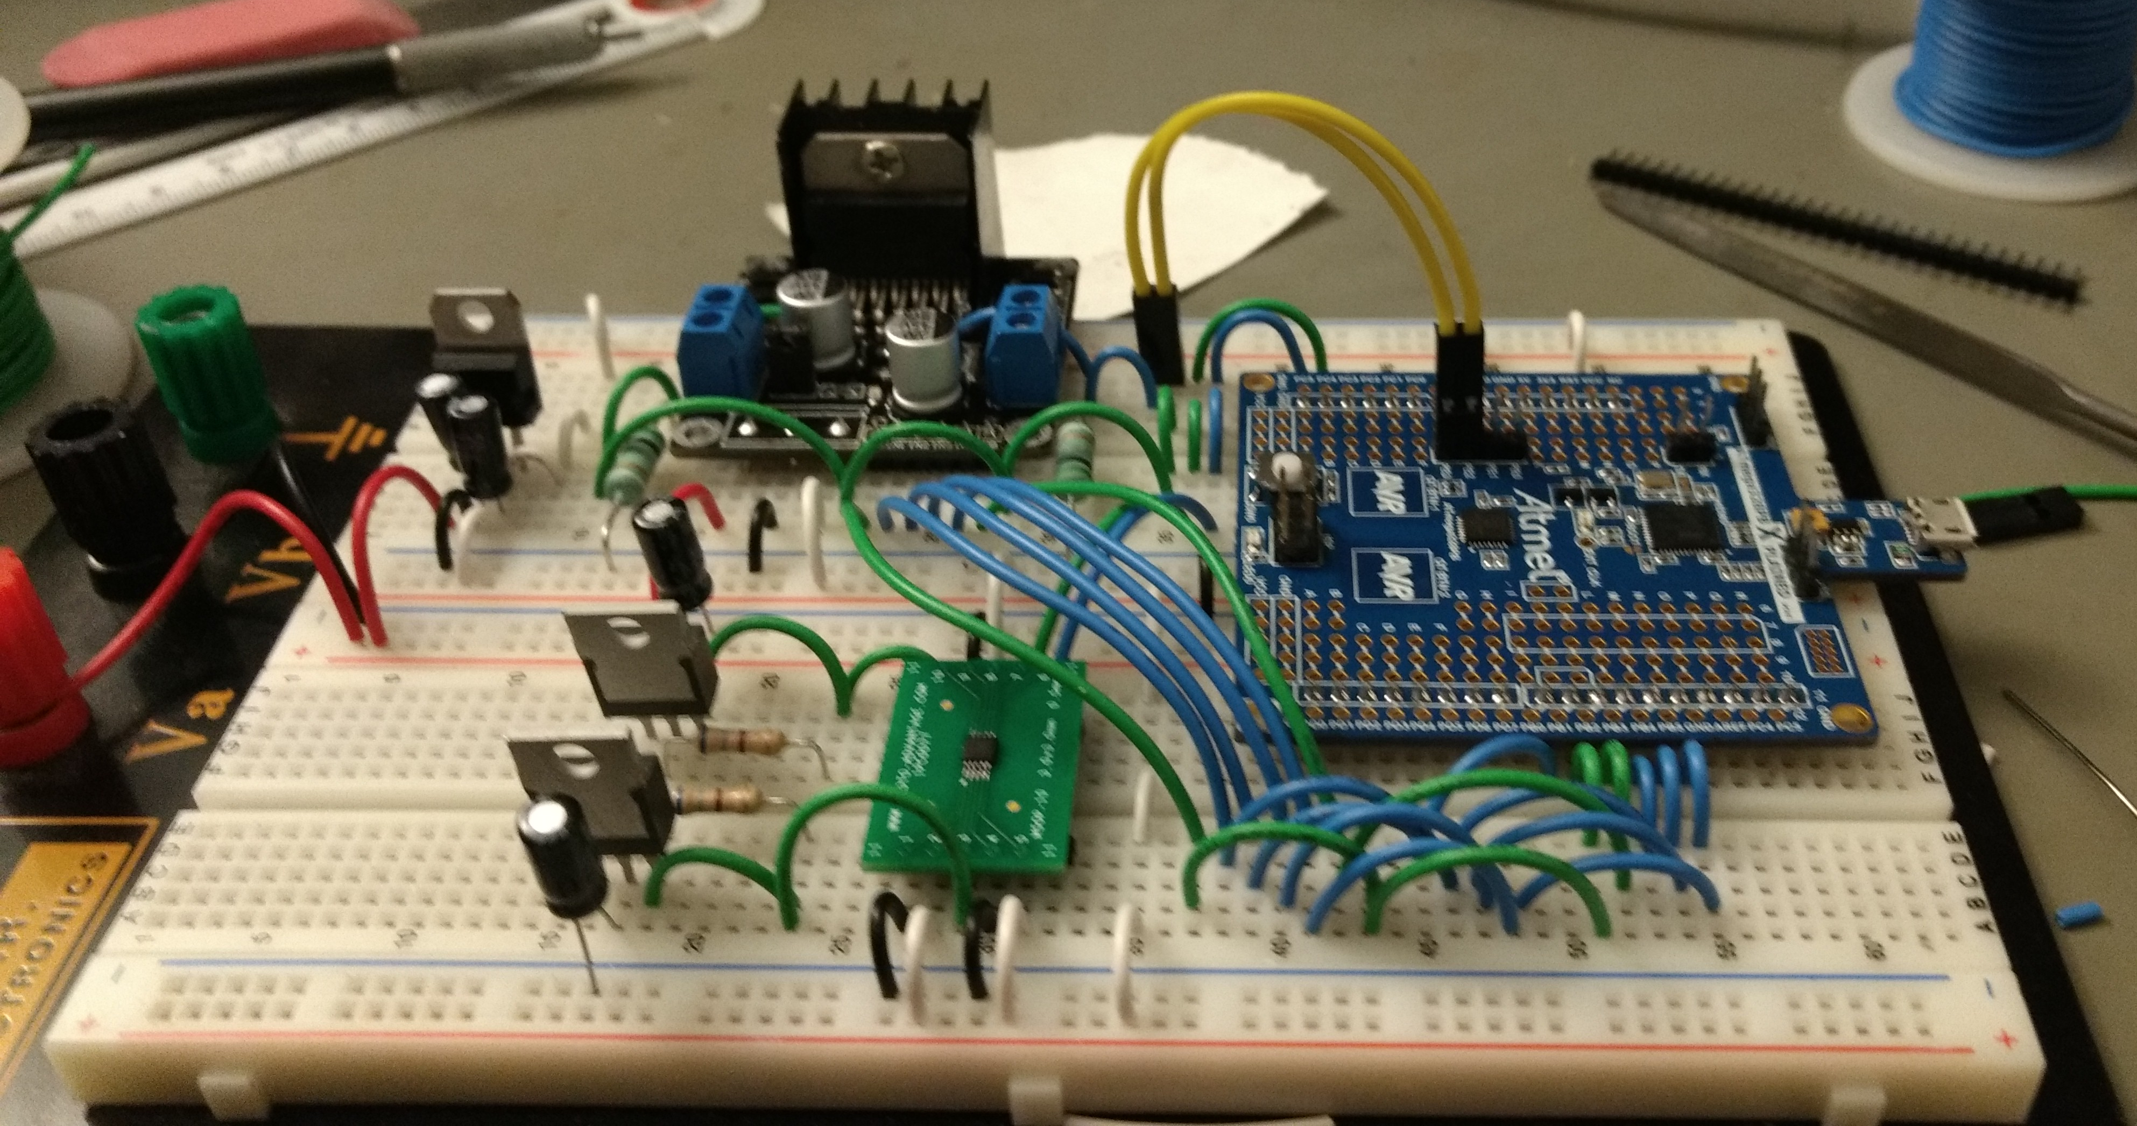
Task 4 Design Verification Completed Test Assembly
Notes:
Connect bottom ground and add 10k pull up resistor

Slide 32
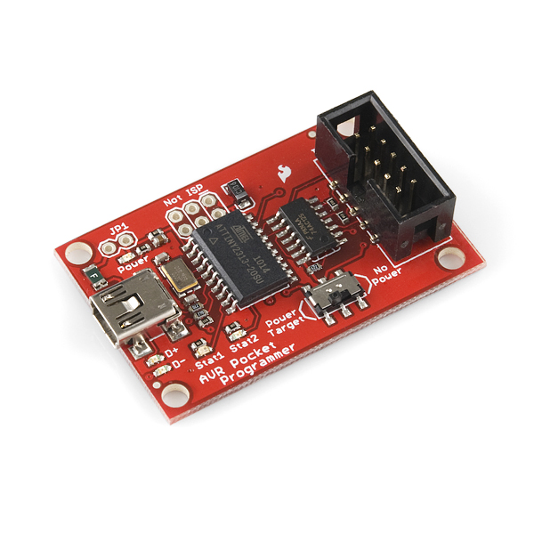
Task 4
Programming/Debugging:
Sparkfun Pocket AVR Programmer
Inexpensive
Can program all microcontrollers supported by AVRDUDE
Works with microcontrollers with 64KB or less memory
Also supports single wire debugging

Slide 33

Task 4 Design Verification: IDE Selection
Atmel Studio
Free
Compatible with multiple AVR programmers
Software Simulation for most AVR microcontrollers

Slide 34
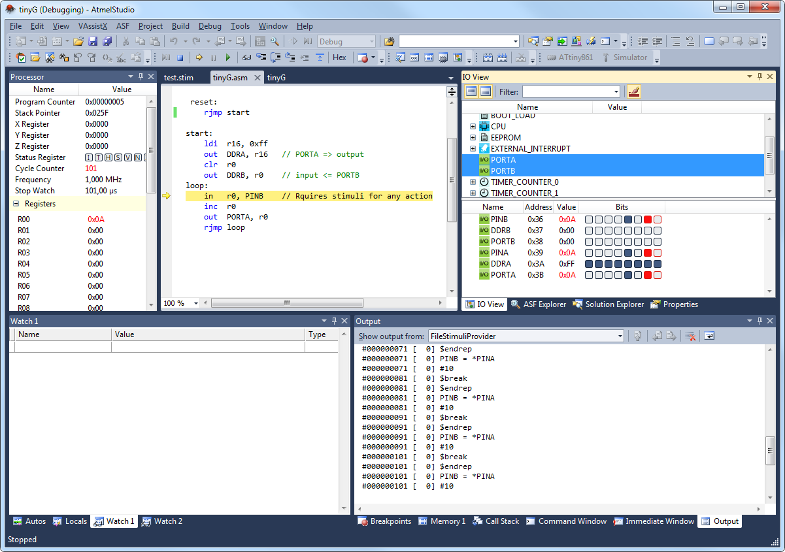
Simulated Stimuli on Atmel Studio

Slide 35
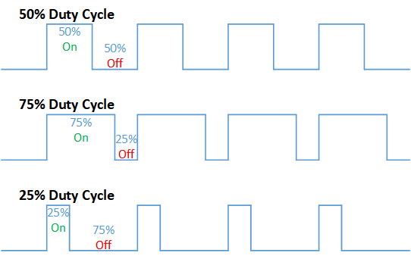
Task 4: Control Section Design Microcontroller: PWM
A modulation technique that encodes information into the width of a regular pulse.
Current control can be achieved by varying the amount of time that a device is on.

Slide 36
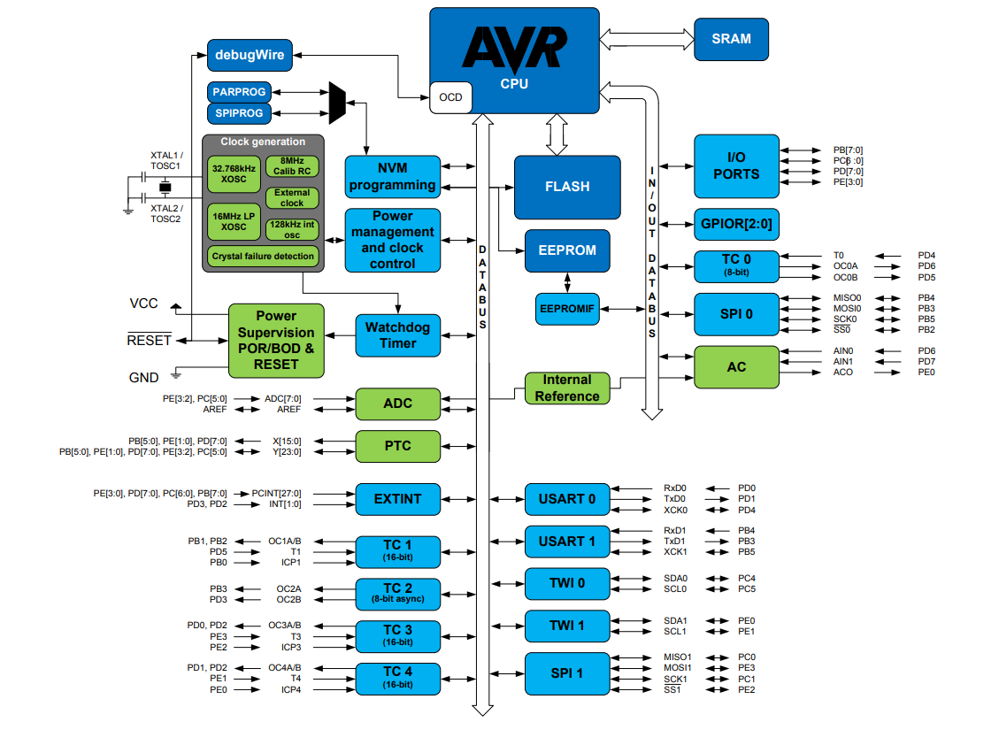
Task 4
ATmega328PB Block Diagram

Slide 37
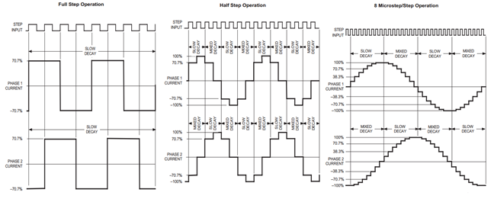
Task 1: Design Verification Motor Control
Dual DC Motor Operation
Vary input logic for different combinations of forward, back, and stop
Use PWM to vary power to each motor individually

Slide 38
Task 4

Slide 39
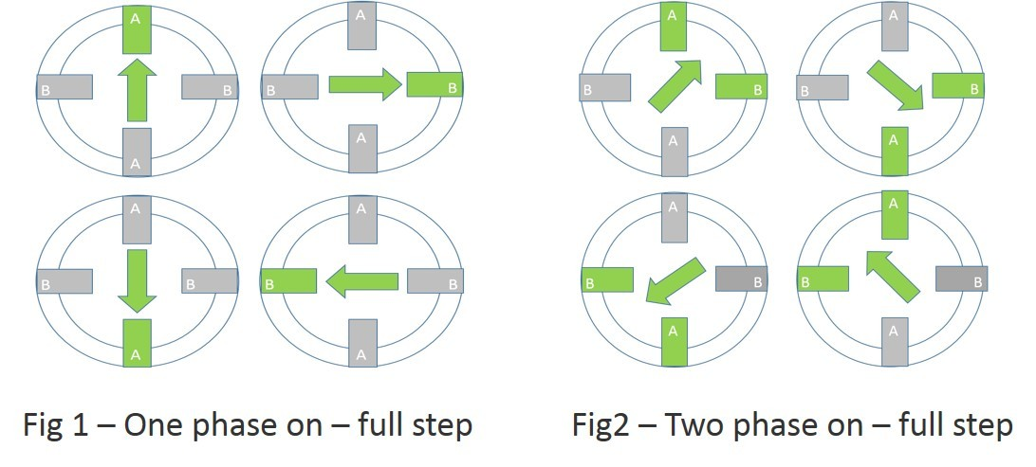
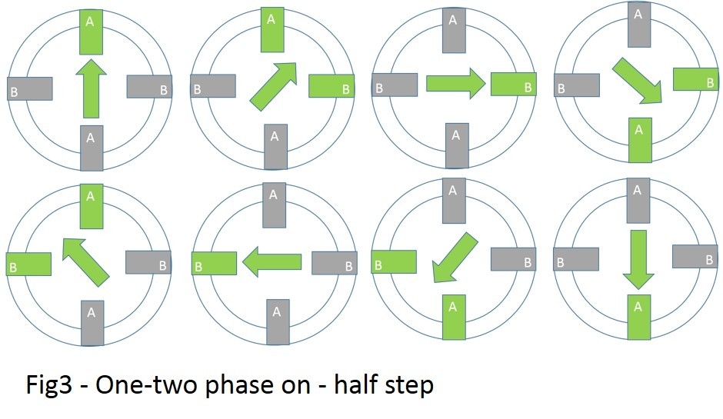
Task 4: Design Verification Motor Control
Full, Half, and MicroStepping
Full and Half stepping relies on input logic.
Microstepping varies power to each winding in varying proportion.
PWM to vary power by duty cycle

Slide 40
Task 4

Slide 41
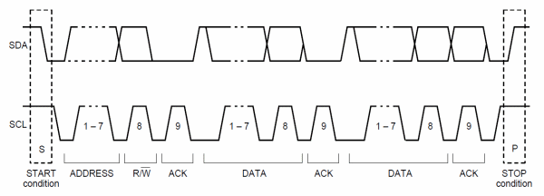
Task 1 Control Section Design Microcontroller: I²C
Serial communication protocol transfers information one bit at a time.
Addressed devices are connected to same line
Devices respond when they see their address after the start condition.

Slide 42
Task 4

Slide 43
Task 5 : PCB Design

Slide 44


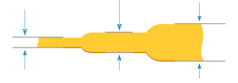
Task PCB Design
OSHPARK design rules
$5 per square inch
Order in Multiples of three

Slide 45
Task PCB Design
PCB layout guidelines
Keep Trace Lengths Short
Power and Ground Planes
Group Related Components Together

Slide 46
Task PCB Design
Recommended Circuit Layouts

Slide 47
Task PCB Design
Via and Trace Calculation

Slide 48
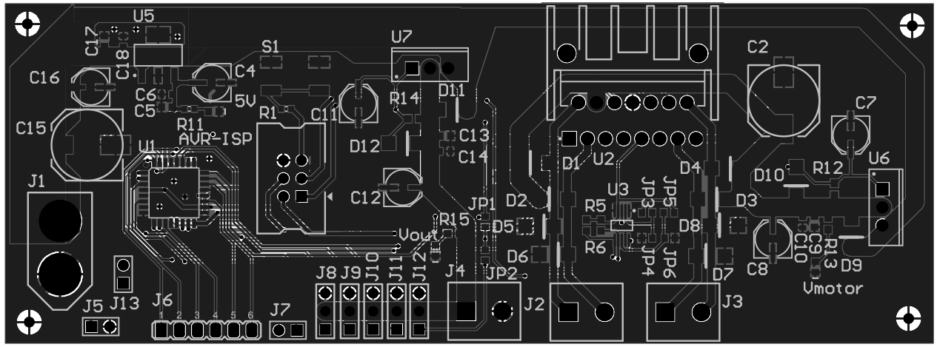
Finalized PCB in Circuit Maker

Slide 49
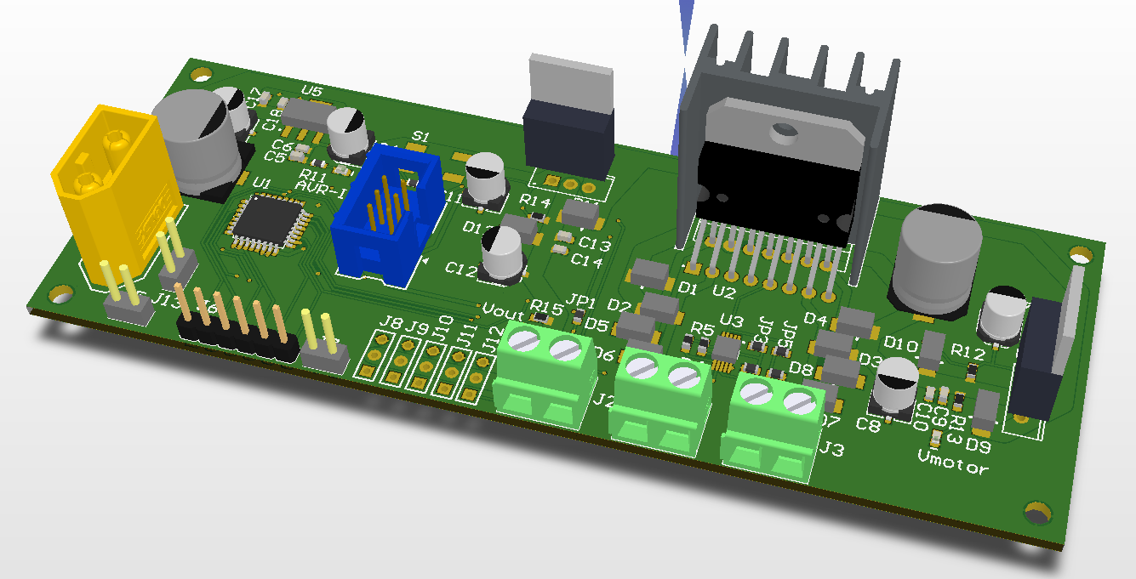
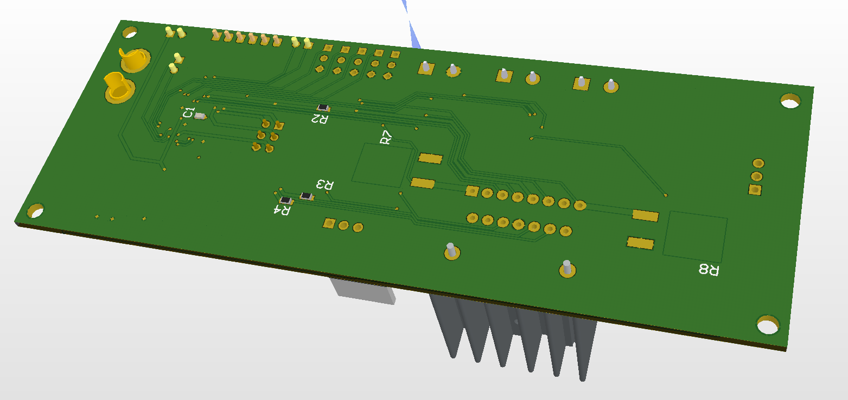
Finalized PCB in Circuit Maker

Slide 50
Task PCB Design
Bill Of Materials Production
Part Selection In Schematic Design
Octopart BOM Tool
Total Part Cost

Slide 51
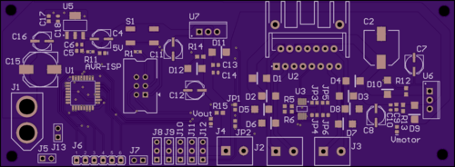
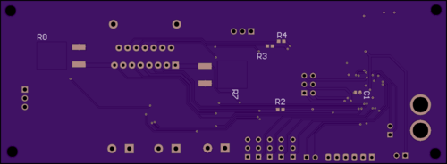
OSHpark Production Render

Slide 52
Questions?

